Slide 1
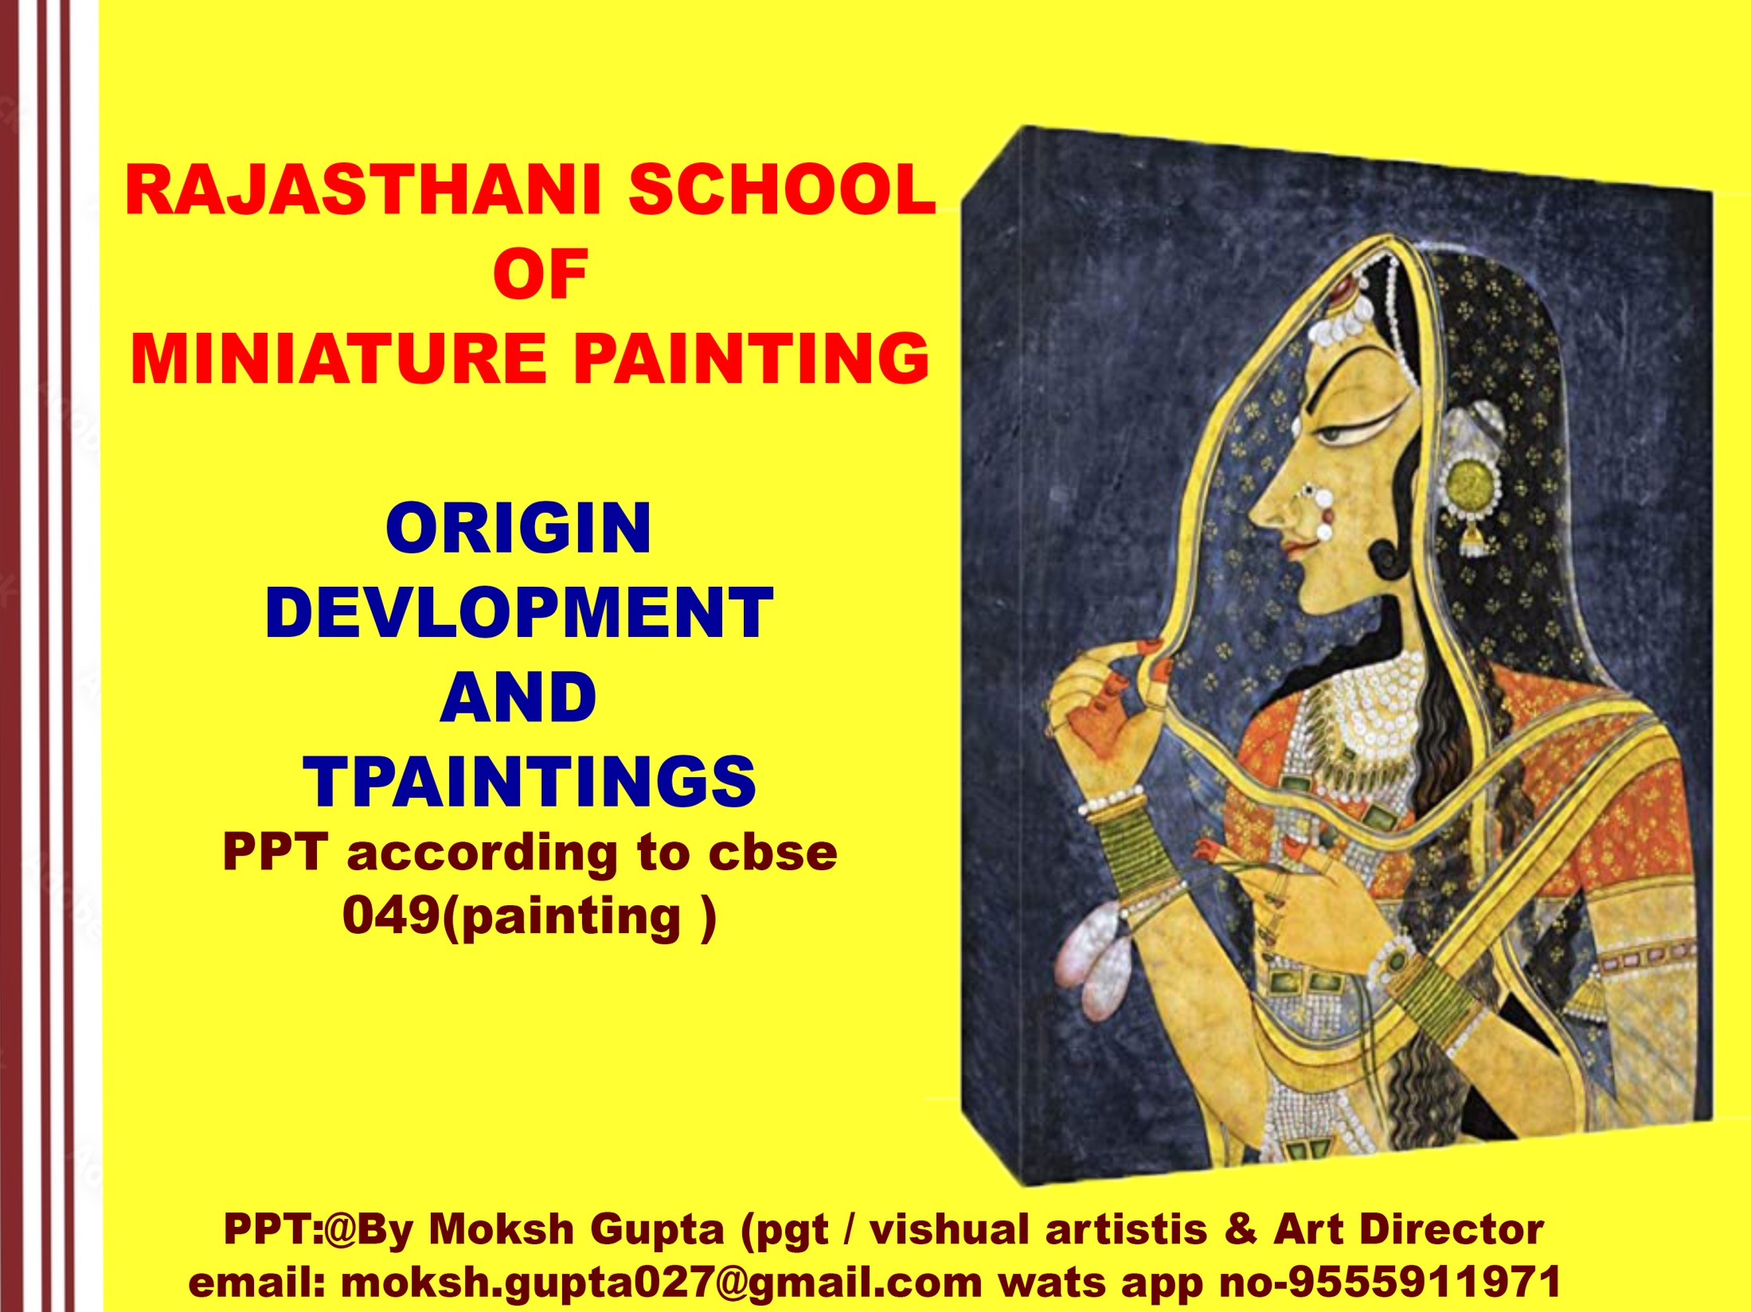

Slide 2
RAJASTHANI SCHOOL
Revision
INTRODUCTION
ORIGIN AND DEVELOPMENT
SUB-SCHOOLS – MEWAR , BONDI, JODHPUR, BIKANER, KISHANGARH, JAIPUR
PANTINGS
TITLE | ARTIST | SUB SCHOOL
Maru Ragini | Sahibdin | Mewar
Chaugan Player | Dana | Jodhpur
Krishna on swing | Nuruddin | Bikaner
Radha (Bani Thani) | Nihalchand | Kishangarh
Bharat meets Ram at Chitrokut | Guman | Jaipur

Slide 3
INTRODUCTION :
GEOGRAFICAL STIUATION: Rajasthan is surrounded by Pakistan, Punjab, Haryana, Uttar Pradesh, Madhya Pradesh and Gujrat.
Rajasthan means place of Rajas (king) or Place of state (Rajaya’s ) so there were so many kings and states at that time and this place is known as Rajasthan.
Rajasthan Art is not a new school of art but it was a refined and purified form of the same Indian Traditional Art which was developed in Rajasthan Gujrat and Mewar as a new school of art is also known as Rajasthani or Rajput or Hindu school of art. This art was based on Hindu literature, Music, poetry, Religion, Rag, and Rani Ritikala Paintings etc.
ORIGIN
Rajasthani School did not originated as miniature but it was primarily a mural art. This art was devloped under Rajput kings so it is called Rajput art. A number of panting's were done on romance and general folk art. The whole Rajasthan was affected by the attack of the mughal but Mewar did not came under their control till the last. This was the resson that Rajasthani school flourished first in mewar. And later in Jaipur, Jhodhpur, Ambar, Kota, Bundi, Krishan Garh, Bikaner school etc. Mewar has an important place in the development of Rajasthani school of art. It is a mixture of gujrat and jain school along with original Indian Art. But Rajathani school of art is a pure indian art. Even today Nathwara painting are very famous more of the painting depict love scenes of Radha and krishna .

Slide 4
15th Century is supposed to be the time of revival of Hindi Literature and painting. Literature,Music, Art, Architecture all saw a new dawn in this period. Paintings on Krishna legends,religion, Ragmala and Ritikala poetry etc. were done during this period. This was not the traditional Apabhransha style of painting but it was the refined and purified form of thesame which originated in Gujrat and Mewar as a new school. This was called asRajasthani, Rajput or Hindu school.
DEVELOPMENT
In the beginning the paintings of this school remained confined to different kings for their amusement. The artists though prepared precious paintings but gradually the paintings reachedthe common man. Several precious paintings were destroyed by the Mughals in 16th and 17thCenturies but the paintings that had reach the common man are still there is abundance, on thebasis of which we find different styles of Rajasthani school.Initially this style was inspired by religion as the followers of Ramanuja like Sur, Tulsi, Meera,Vallabhacharya and Chaitanya Mahaprabhu had taken the expansion and publicity of HinduVaishnava religion to climax.
Early Rajasthani paintings are extremely simple and straight forward in composition inwhich figures are presented against the solid back-grounds of dark colours. Vivid andglowing colours flatly laid within definite out lines, architectural setting, stylized treatment of trees and plants are some of the characteristics of the Rajasthani miniatures .In later stagepaintings were done on romance and folk themes.

Slide 5
Themes of Paintings – An Overview
By the sixteenth century, Vaishvanism in the cults of Rama and Krishna had become popular in many parts of western, northern and central India as part of the Bhakti movement
that had swept the entire Indian subcontinent. Krishna had a special appeal. He was not only worshipped as God but also as an ideal lover. The notion of ‘love’ was cherished as a
religious theme, where a delightful synthesis of sensuousness and mysticism was perceived. Krishna was perceived as the creator from whom all creation was a sportive emanation,
and Radha, the human soul who led to offer herself to God. The soul’s devotion to the deity is pictured by Radha’s self-abandonment to her beloved Krishna epitomised in
Gita Govinda paintings. Composed in the twelfth century by Jayadeva, who is believed to have been the court poet of Lakshmana Sen of Bengal, Gita Govinda, the ‘Song of the Cowherd’, is a lyrical poem in Sanskrit, evoking shringara rasa, portraying the mystical love between Radha and Krishna through worldly imageries. Bhanu Datta, a Maithil Brahmin who lived in Bihar in the fourteenth century, composed another favourite text of artists, Rasamanjari, interpreted as the ‘Bouquet ofDelight’. Written in Sanskrit, the text is a treatise on rasa and deals with the classification of heroes (nayakas) and heroines (nayikas) in accordance with their age — baal, taruna and praudha; physiognomic traits of appearance, such as padmini, chitrini, shankhini, hastini, etc., and emotional states, such as khandita, vasaksajja, abhisarika, utka, etc.
Though Krishna is not mentioned in the text, painters have introduced him as the archetypal lover.

Slide 6
Rasikapriya, translated as ‘The Connoisseur’s Delight’, is replete with complex poetic interpretations and was composed to incite aesthetic pleasure to elite courtiers.
Composed in Brajbhasha by Keshav Das, the court poet of Raja Madhukar Shah of Orchha in 1591, Rasikapriya explores various emotive states, such as love, togetherness, jilt, jealousy, quarrel and its aftermath, separation, anger, etc., that are common between lovers represented through the characters of Radha and Krishna.
Kavipriya, another poetic work by Keshav Das, was written in the honour of Rai Parbin, a celebrated courtesan of Orchha. It is a tale of love and its tenth chapter evocatively
titled Baramasa engages with the most enduring climactic description of the 12 months of the year. While illustrating the daily life of people in different seasons and alluding to
festivals falling therein, Keshav Das describes how the nayika prevails upon the nayaka not to leave her and proceed on a journey.
Bihari Satsai, authored by Bihari Lal, constituting 700 verses (satsai), is composed in the form of aphorisms and moralising witticism. It is largely held that he composed the Satsai around 1662 while he was at the court of Jaipur working for Mirza Raja Jai singh as the patron’s name appears
in several verses of the Satsai. The Satsai has been largely painted at Mewar and less frequently in the Pahari School. Ragamala paintings are pictorial interpretations of ragas and raginis.
Bardic legends and other romantic tales, such as Dhola-Maru, Sohni-Mahiwal, Mrigavat, Chaurpanchashika and Laurchanda just to mention a few were other favourite
themes. Texts, such as the Ramayana, Bhagvata Purana, Mahabharata, Devi Mahatmya and the like were favourites with all schools of painting.

Slide 7
SUBJECT MATTER OF RAJASTHANI SCHOOL
1. Religious Themes - Religious themes based on Ramayana and Bhagwat have been
painted with ample devotion.
2. Romantic Scenes - Romance of Radha and Krishna was the main subject , painted in this style. Krishna with Gopis have also been beautifully painted.
3.Nayika Bheda,and Ragmala – These are some of the most liked subject of that time.Many series have been painted on such themes.
4. Litrary Themes- Beautiful paintings were done on Geet-Govind , Bihari chandrika ,RasikPriya ,Ram-Chandrika etc.
5. Barahmasa – Lots of paintings have been done on twelve different seasons found in India.They are known as barahmasa.
6. General life - The artists of this school have also painted the general life of masses such asmarriage scenes, processions, dances and music and even village scenes etc
7. Portraits , Court scenes and Hunting scenes have also been painted in Rajasthani school.
Portrait of Radha popularly known as Bani- Thani compared with Mona Lisa is praise worthy.

Slide 8
CHARACTERISTICS OF RAJASTHANI SCHOOL
Depiction of Woman
The artist of this school has excelled in the painting of women. The most important characteristics of Kishan Garh school is the depiction of women. Women have been painted slim,flexible & tall like creepers. Faces are also long with high and sloping foreheads, pointed long nose and bulging out well cut lips. Chin is also little longer.
Eyes have got special place in Kishan garh school. Fish shaped long drawn eyes and bow like eyebrows have been painted beautifully but figures in Mewar school are of small size .
Garments
The ladies have been shown wearing Lahanga and Choli and transparent Chunni but at some places Sari has also been painted. Male figures have been shown wearing high turbans on their heads.Pajama and Rajput style Patka is also there. In religious paintings Krishna has been painted with yellow garments. Pearl jewellery is worn by the figures is the special feature of Kishangarh paintings.
Colour Scheme
Mostly Primary colours have been applied in this style without mixing but different colours have been used in the background. White, gold and silver colours have also been used.

Slide 9
Depiction of Nature
In Rajasthani school nature has been very skillfully depicted to suit the emotional aspect of main figures. The back-ground of nature has added charm to
the main theme of the painting. Along with the trees mountains , water springs etc. arefound in this school.
Depiction of Birds and Animals
Birds and animals have been beautifully depicted which is the effect of Mughal School. In Mewar school elephants and horses have been speacially painted.
Night Scenes:
Night scenes have been beautifully painted in Rajasthani school. The yellow light of the lampsis really attractive and the moon light scenes are also charming. The sky is coloured in black and smoke colours.
Architecture
From marble to brick work all the techniques of architecture are used. In the depiction of palaces the effect of Mughal school is clearly seen.Big courtyards, walls and forts have been painted.
Boating Scenes Boating
scenes are full of life and rhythm. Boat scenes are mostly painted in Kishangarh school.
Symbolic Paintings
Radha and Krishna have been shown in the form of soul and God.

Slide 10
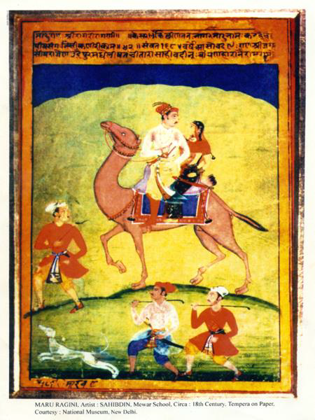
Title: - Maru Ragini
Artist - Sahibdin
Medium - Tempera on paper
Period - Early 18th Centuary.
School – Mewar
SUBJECT MATTER/COMPOSITIONAL
Maru Ragini is the painting from the series of Ragamala painted by Sahibdin ,the court
painter of Mewar. The king with his queen is riding on a camel against the yellow desert
background. The fore ground is painted in the light washes of green. The camel is being led by an attendant.
Two male escorts are running along the camel, riding royal couple. They carry sticks in their
hands. A hunting dog is also running ahead of those escorts. The sky is deep blue color. The dress of all the figures are in flat colors. Transparent white colour has been used in the painting. Camel is well decorated. The king is holding a flower in his right hand and looking at the queen. On the top of the painting Maru Shre Ragani is written. The colours are bright and natural, which tell the story of heroines and hero.

Slide 11
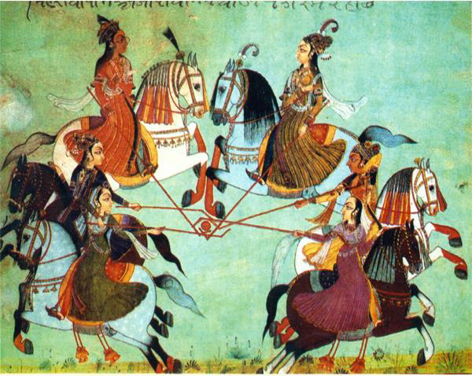
Title - Chaugan Players
Artist - Dana
Medium - water colour
Technique -Tempera on paper
Period - Circa- 18th century
School - Jodhpur (Rajasthan)
SUBJECT MATTER/COMPOSITIONAL
The painting Chaugan Players is of a group of polo players, all mounted on horse backs with
polo sticks in their hands. Two princesses are playing polo with their maidsThe two horses in the upper section of the painting are galloping towards each other while theplayers in the lower section are moving in the opposite directions.Their upper bodies are twisted backward to tackle the ball with their long polo sticks .They allare dressed in contemporary Rajput costumes.Faces have high rounded forehead profile. Their eyes are elongated. Their Skirts are spread out like bells with the movement of their action.The painting is full of dynamic movements against a little green landscape. Brilliantly coloured
figures create a harmonious contrast.

Slide 12
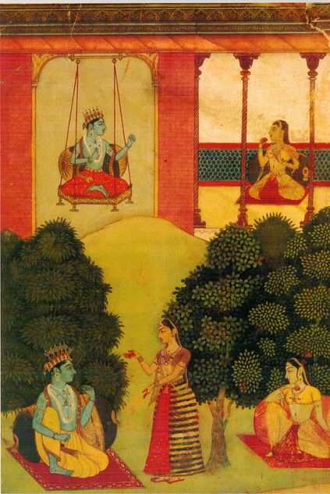
Title - Krishna on swing
Artist - Nuruddin
Medium - water colour ,Tempera on paper
Period - Circa- 16th century
School - Bikaner (Rajasthan
SUBJECT MATTER/COMPOSITIONAL
The painting Krishna on swing is yet another marvelous achievement of this period The painting has two panels depicting Krishna and Radha in two different scenes.
On the first part of the panel , Krishna is shown sitting on a swing on the left side of the panel while Radha is sitting in front of him in the balcony on a red carpet. They both are looking at each other. The swing has an ornamental border in hexagonal shape. Krishna has shown in bluecomplex wearing an orange coloured dhoti.
In the lower panel both Radha and Krishna are sitting in a garden at two different places. Anattendant of Radha is also shown in the painting who has perhaps brought a message for Krishna. Here he is wearing dhoti of yellow colour. Both are sitting on red carpet supported by big pillows. Radha is wearing yellow coloured dress. Attendant is wearing striped ghaghra and light purple coloured blouse. Both trees and a mound in the back ground are drawn in typical Rajasthani style .

Slide 13
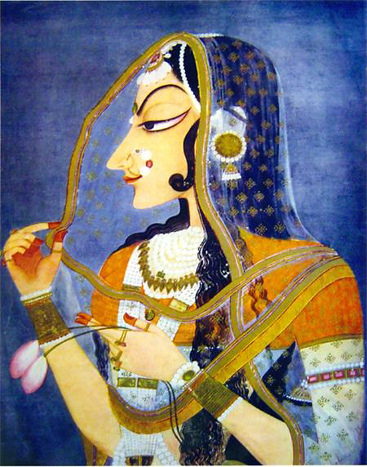
Title - Radha ( Bani Thani)
Artist - Nihal Chand
School - Kishangarh
Period - 1760 A.D.
Medium - Tempera on paper
SUBJECT MATTER/COMPOSITIONAL
Radha Bani Thani is one of the most well known paintings from Kishangarh. Nihalchand’s fame rests on this painting which is highly stylized portrait of RadhaThis idealization of Radha is the supreme achievement of Rajasthani painting. Hence, it is called Monalisa of India.A postal stamp of Radha Bani Thani was issued by the Government of India.
Her half closed eye lends an enigmatic quality, the corner of curled mouth as about to break into
a smile. Her long jet black hair flows down from shoulder to the waist and a lock of hair is partly
falling on her cheek. The treatment of the hair is obviously borrowed from Mughal painting of
late Aurangzeb period.She has a receding forehead, pointed nose, pointed chin, arched eyebrow and thin red lips. Long tapering fingers of her left hand are holding two lotus buds while she is delicately holding theedge of odhini by the right hand.

Slide 14
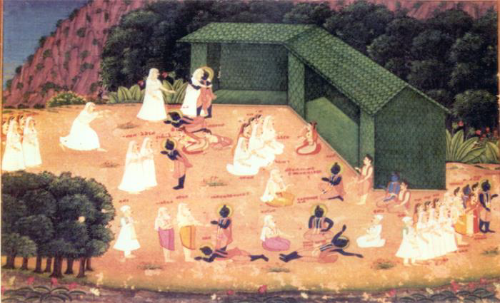
Title - Bharat meets Rama at Chitrakut
Artist - Guman
School - Jaipur School
Medium - Tempera on paper
Period - 18th Century
SUBJECT MATTER/COMPOSITIONAL
It is a very well executed painting of Jaipur school. Painter Guman has done a wonderful
presentation of 49 figures on the small canvas relating the entire story in an episodic form.The painting depicts a scene from Ramayana, when Bharat comes to Chitrakut to meet Rama,Sita and Lakshman with his three mothers, Guru Vishwamitra and some courtiers.
This painting is unique for its compositional arrangement. A new set of figures is used to depict the each stage of the meeting. In the centre of the painting Ram is shown fainted on hearing the news of his father’s death. A little on the left of this group, Ram is shown touching the feet of hisguru, Lakshman stands nearby facing Vishwamitra with folded hands.In the foreground is a little stream with lotus flowers and leaves. Behind a hut , a group of lush
green banana trees is painted in the luminous shades of green. The huts of Ram ,Sita and Lakshman stands out against the dense and lush green forest.

Slide 15


